Slide 1
Birthday Party Fiasco!
Fall 2020

Slide 2
What is Chemical Engineering?

Slide 3
Chemical Engineers know how to:
Apply Math, Physics, Chemistry, & Biology to solve problems
Design processes that produce high quality products in large quantities and at low costs
Produce, Transform, Transport, Use

Slide 4
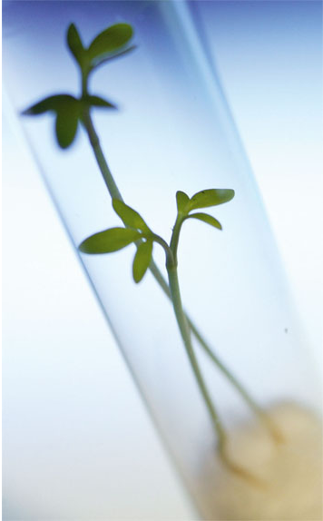
What are the roles of a chemical engineer?
Design, sell, & market new products
Design processes to produce products
Economics (profit!)
Environmental concerns
Research and development of new technologies
Solve problems!

Slide 5
Where do Chemical Engineers work?

Slide 6
Notes:
What’s great is that you can work in almost any industry, in any area/technology available

Slide 7
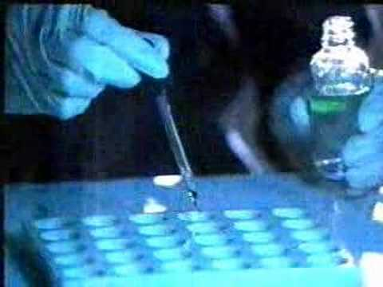
Chemical Properties
The more properties of a substance we can identify the better we know the nature of the substance
Engineers can use this to identify mystery substances

Slide 8
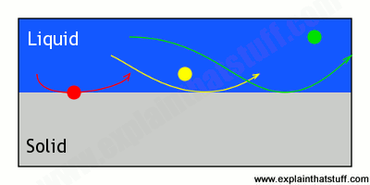
Chromatography
Separating components of a mixture from one another based on their properties
Mobile phase
Stationary phase

Slide 9
It’s your birthday!
Your friends Taylor, Carly, and Harry couldn’t make it to your party so they sent their gifts but with the cards smudged, so you don’t know who sent the cake!
Test their favorite pens to find out who sent the cake!
Carly
Taylor
Harry

Slide 10
Colorful Chromatography
Supplies:
3 sheets of chromatography paper
3 different pens
1 Sharpie
1 cup of water

Slide 11
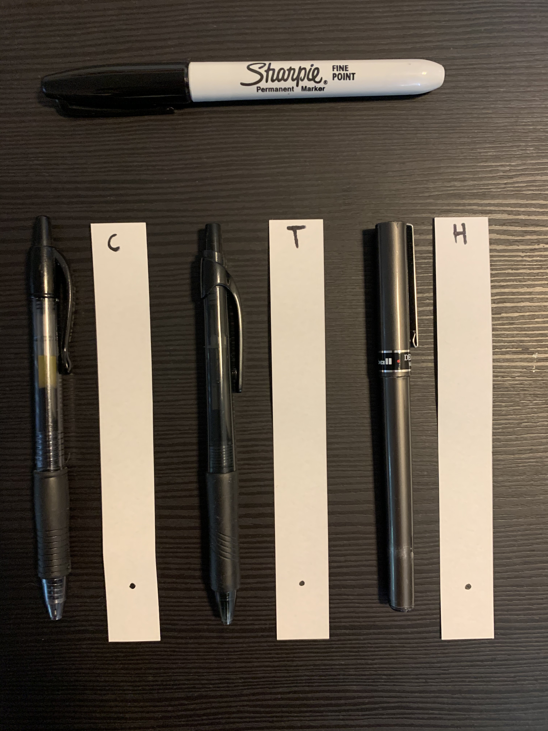
The Favorite Pens
Carly loves the Pilot G2!
Taylor really likes her Mr. Pen!
Harry prefers Paper Mate Erasable pens!
Label the tops of the strips with their initial in Sharpie
Place a dot with the pen about 1 inch from the bottom of the paper

Slide 12
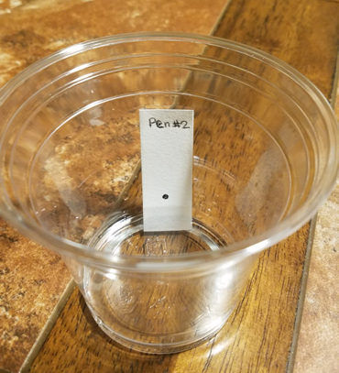
Chromatography Time!
Place the strips in a cup with about 2-3 tablespoons of water
Keep them there for 2 minutes
Take them out and place on dry surface

Slide 13
Who gave you the cake?
From a sample on the card, you know that the person who gave you the cake wrote with this pen
Can you match this with any of your samples?

Slide 14
Debriefing
Whose favorite pen was used to write the note?
What was the mobile and stationary phases?

