Slide 1
Let’s Make Oobleck!
PPSO FEMMES Capstone

Slide 2
What is Oobleck?
Oobleck is a substance made from cornstarch and water (and food coloring to make it colorful).
This is a substance that can act as both a solid and a liquid!
Like a liquid, it will take the shape of whatever it is in.
For example, if you put it in a bowl, it will take the shape of the bowl.
Like a solid, it will take the shape of whatever is holding it.
For example, if you hold it in your hands like the shape of a ball, it will feel like a ball.
If you push your hand slowly into it and grab it, it will be more liquidy, BUT, if you slap it, it will feel more solid!

Slide 3
Now, Let’s Get to Making it!
Materials You Will Need
A bowl
1 cup of cornstarch per student (or if in a group of 2-3, 2 cups of cornstarch total)
½ cup of water per student (or if in a group of 2-3, 1 cup of water)
A few drops of your favorite color of food coloring (optional)

Slide 4
Instructions
Measure out the amount of cornstarch you are using (1 cup for 1 student or 2 cups for a group of 2-3), and put it in the bowl
Measure out the amount of water you are using (½ cup for 1 student or 1 cup for a group of 2-3), and put it in the bowl with the cornstarch
Mix them together with either a spoon or your hand!

Slide 5
Now that You’ve Made the Oobleck, What Should You Do With It?
Whatever you want with it! Except, don’t eat it!
One thing you can do is dip your hand into it slowly and feel it be liquidy.
Another thing you can do is grab it and hold it/form it into a ball in your hands; it should feel like a solid.
One last thing you can do is keep it in the bowl, and then slap it! It should feel like a solid when you slap it.

Slide 6
Why Does Oobleck Feel Like a Solid Sometimes, but also a Liquid?
Oobleck is a non-Newtonian fluid, which means that it does not have a constant viscosity/thickness to it.
For example, something with constant thickness would be water, it is always liquidy, but something like silly putty does not always have the same thickness to it, depending on how you handle it.
So, in the case of Oobleck, the viscosity/thickness increases when you apply fast pressure (like when you slap it), but it decreases when you dip your hand in slowly to grab it.
Also, the cornstarch in the water stays intact, so when you slap it, the grains of the cornstarch rub against each other to lock into position, making it feel like a solid. However, when you slowly dip your hand in, the grains of the cornstarch are more free-flowing and don’t lock in, making it feel like a liquid.

Slide 7
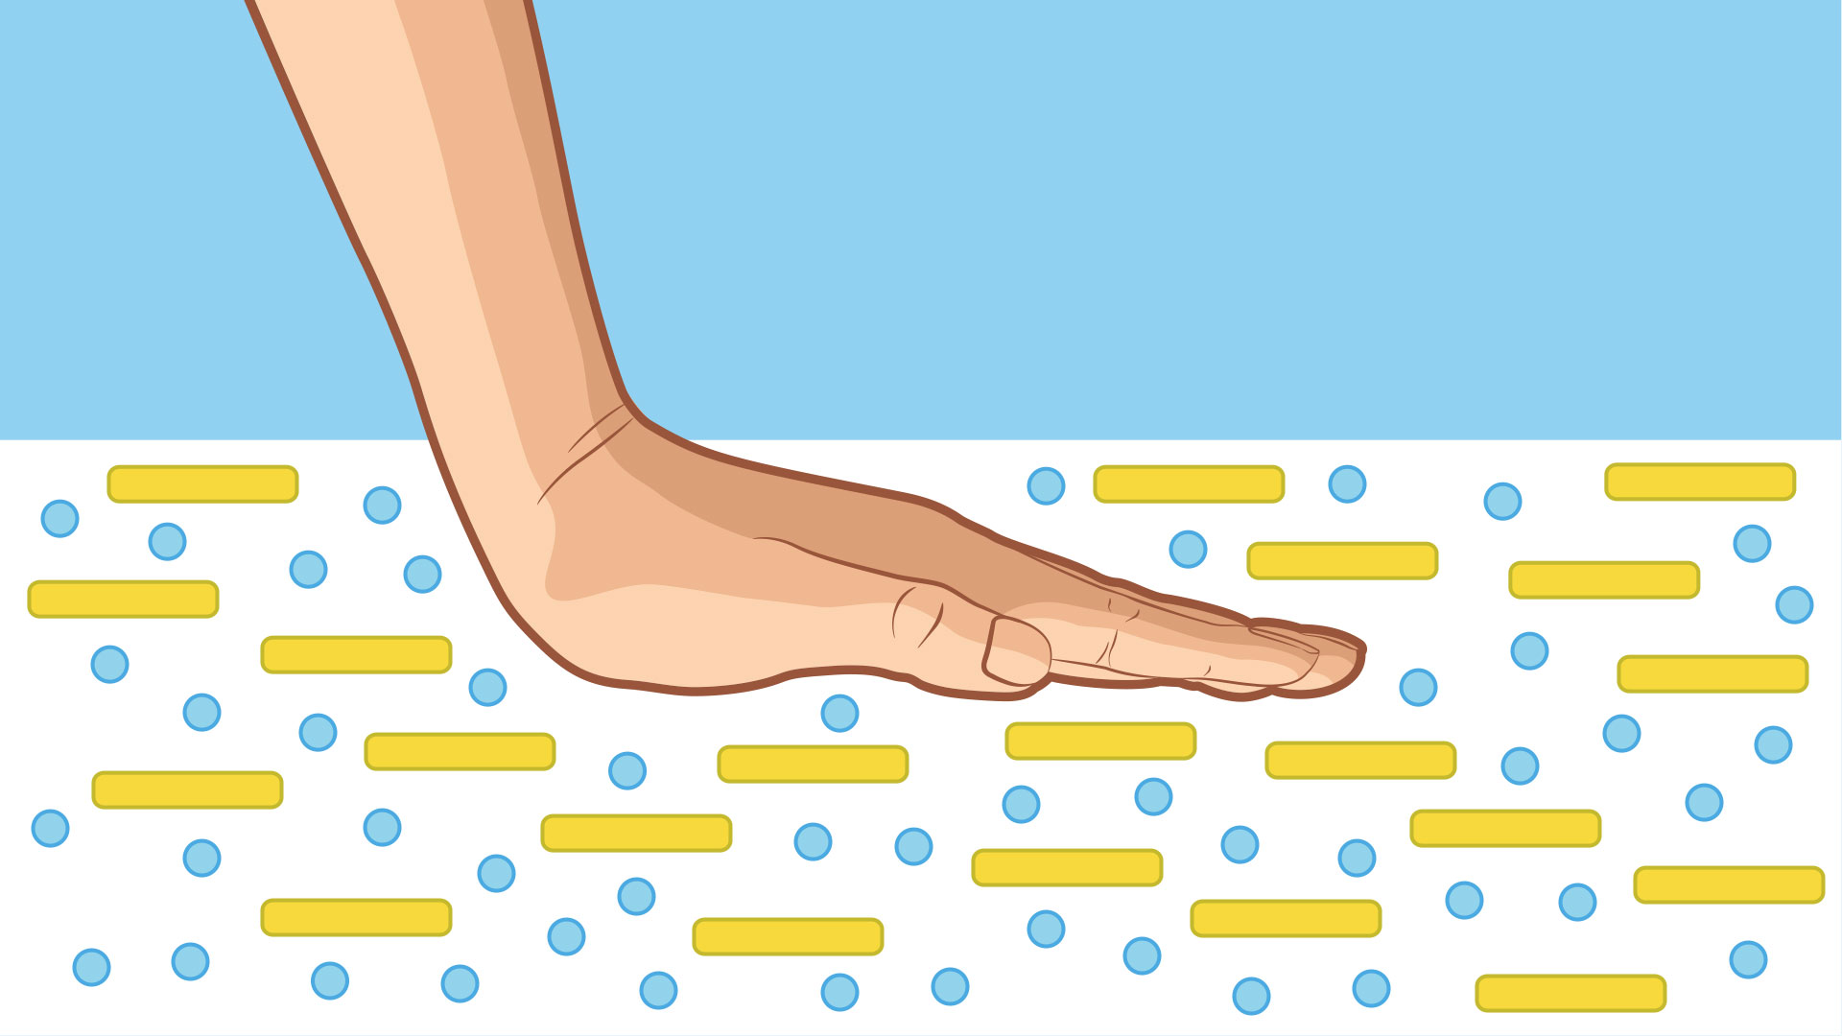
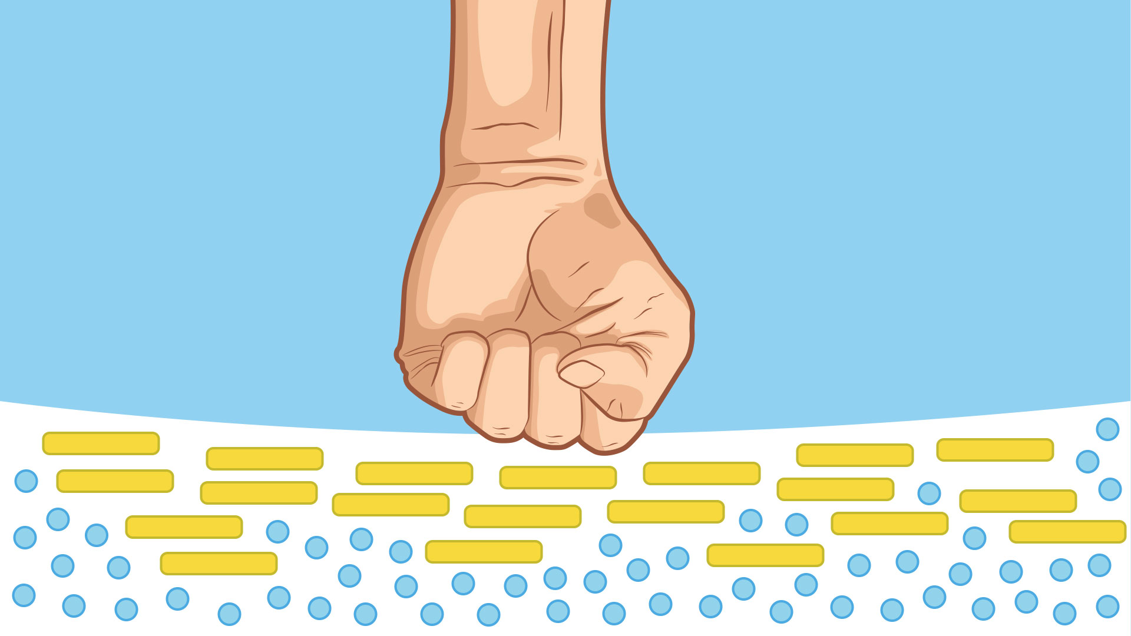
Why Does Oobleck Feel Like a Solid Sometimes, but also a Liquid?
Another reason is that the water acts as a cushion and allows the cornstarch to freely move; so, when fast pressure is applied, the force pushes the water out of the way and makes the grains of the cornstarch rub against each other and lock into place.

Slide 8
Hope you learned something new and had fun!

