Slide 1
F.E.M.M.E.S. Capstone 2020 Blockly Games & Machine Learning

Slide 2
Who Are We?
Girls Who Code at University of Michigan Department of Computational Medicine and Bioinformatics is a student organization
We are PhD students from the University of Michigan in Ann Arbor, as well as Undergrads, Masters students and staff
We code every day!

Slide 3
What is Girls Who Code?

Slide 4
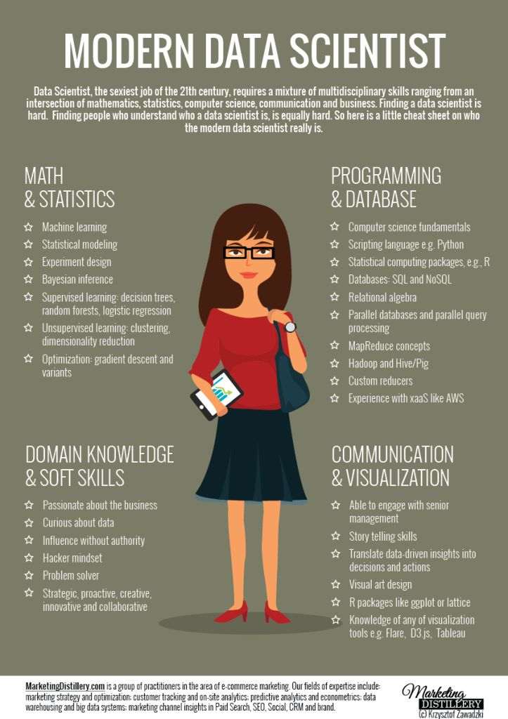
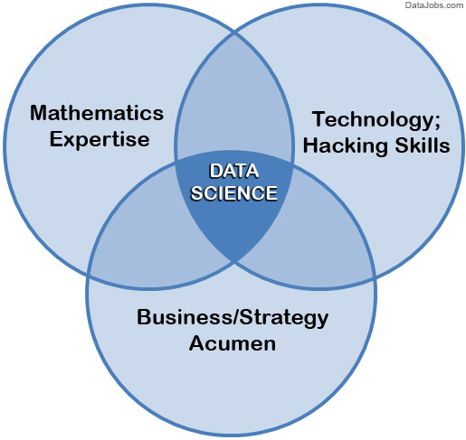
What is Data Science?
Data science is a multi-disciplinary field that uses scientific methods, processes, algorithms and systems to extract knowledge and insights from data

Slide 5
Blockly Games & Machine Learning

Slide 6
Blockly Games
https://blockly.games/

Slide 7
What is Machine Learning?
Machine Learning (ML) is the scientific study of algorithms and statistical models that computers use to perform a specific task without using explicit instructions, relying on patterns in data instead
Machine learning is seen as a subset of AI
Artificial Intelligence (AI) describes machines (or computers) that mimic cognitive functions that people associate with the human mind, such as learning and problem solving

Slide 8
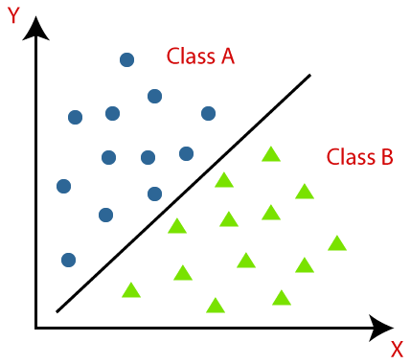
What is an “algorithm” anyway?
An algorithm is simply a step-by-step method of solving a problem
There are many kinds of ML algorithms, specialized for certain kinds of data or operations
One common class of ML algorithms is classification algorithms that sort things into categories (or classes) based on descriptive features

Slide 9
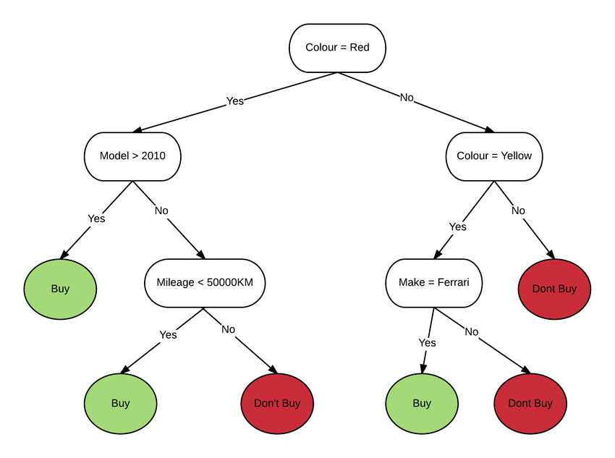
Car Buying Decision Tree

Slide 10
Decision Tree Activity

Slide 11
Handcraft your own Disney-cision Tree!
Part 1: Build a Decision Tree to separate the Disney characters into three categories: Human, Animal, and Other
Note: You will have to “extract” your own features for the characters to build your Decision Tree rule set

Slide 12
Test Your Disney-cision Tree
Lesson: a Model is only as good as the data you use to train it

Slide 13
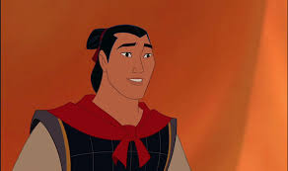
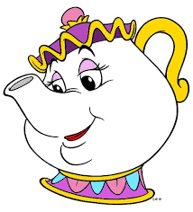
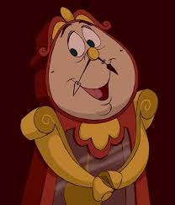

Slide 14
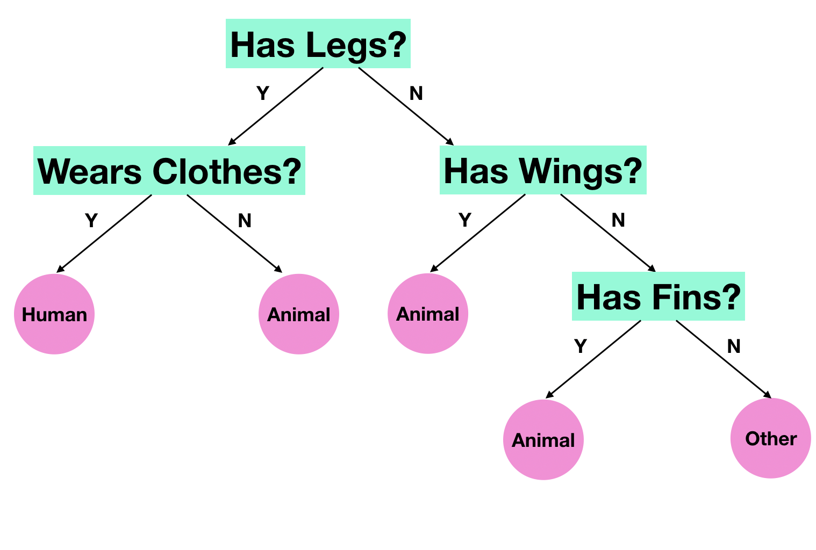
Part 1: Possible Solution

Slide 15
Thank you!!

